Slide 1
Big Mountain Resort Investment/Pricing Strategy
Comparative Analysis

Slide 2
Introduction
Big Mountain is a premier ski resort that wants to maximize revenue
We will explore:
What types of investments should you focus on for growth?
What is the optimum ticket pricing to maximize revenue?

Slide 3
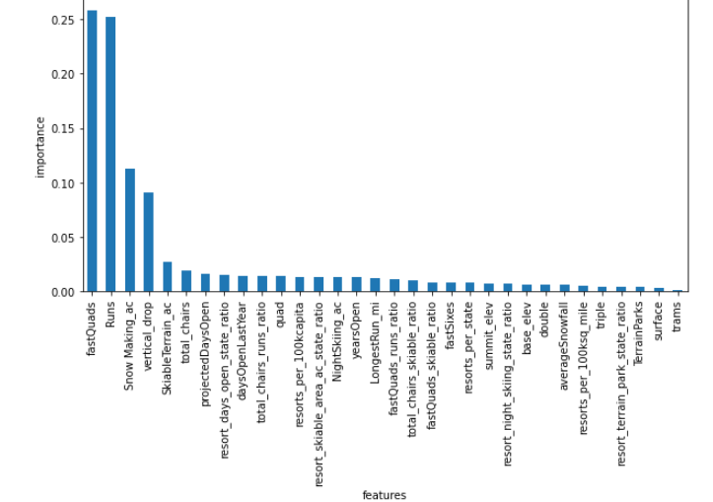
Key Findings
4 main resort features consumers demand
(and will pay more $ for)
# of lifts and their speed
Total number of runs
Snowmaking ability/coverage
Overall vertical drop(mountain features)
Big Mountain is very competitive regarding these 4 features that consumers demand.
Pricing Models suggest Big Mountain could charge more per ticket

Slide 4
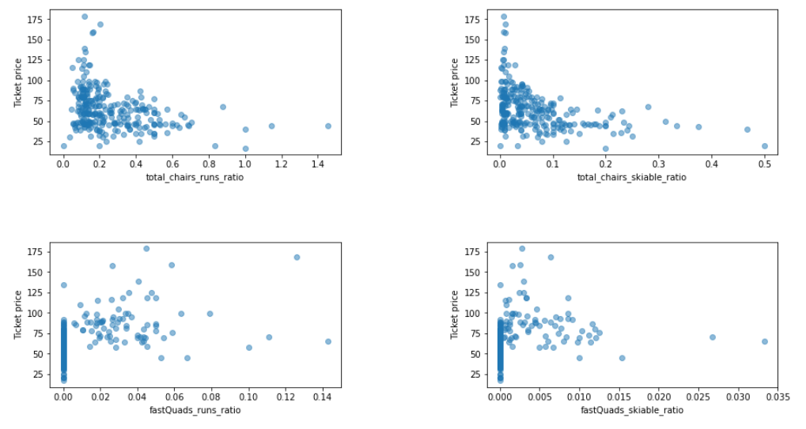
Ticket Pricing Findings
Current Ticket Price = $82
Model Expected Price = $95
Based on Big Mountains comparative features, our model shows ticket prices could be 13$ higher.
The current pricing strategy is leaving $ on the table!

Slide 5
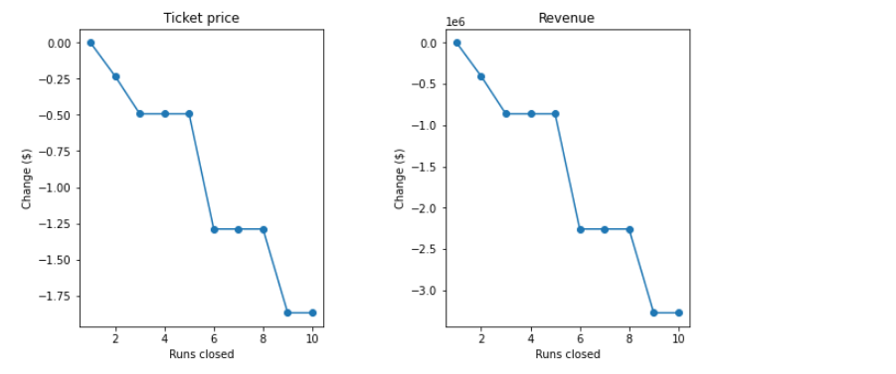
Cost Reduction Analysis
We explore whether shutting down runs can help reduce costs and increase revenue.
Our sensitivity analysis shows that after closing down 3 runs revenue will drop and 6 runs will drop significantly.
Overall its better to maintain the runs than to try and shut them down.

Slide 6
Recommendations
Increase Ticket Prices
A 5-10$ price increase should be sustainable with current resort features compared to competition
Increase Marketing
Investments for Success
Big Mountain needs to focus and build on it’s best features.
Fast lifts,
More runs,
More snowmaking.
Marketing should highlight:
Big Mountain has better facilities than most competitors
Big Mountain invests in features customers want
Big Mountain is the best choice for customers

